Slide 1
Employee retention analysis
Chris Morgan, Eduardo Cantu, Luke Pierce

Slide 2

Identifying employee retention factors
Turnover of key talent can be costly and a major factor in a company’s success or failures
Fortunately, data is readily available in large quantities that can provide insight into the problem.
Fixing the problem requires targeted insights, and by putting data to work, we can better understand the issue

Slide 3

Data Description
Small data transformation work was required
In the data, 237 employees of the 1470 in our data sample were found to have quit there job
The dataset provided included key information for the employee’s professional demographics, job roles, financial information, work history, and professional satisfaction scores among other factors
Fixing the problems requires real data driven solutions

Slide 4
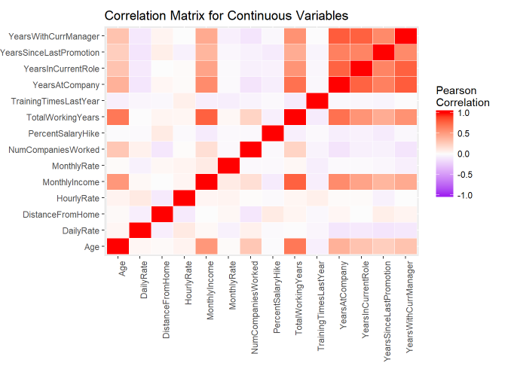
Factor Correlation
Examining the data shows some factors are significantly stronger than others
Interestingly, positive correlation factors are much more present than negative correlation values.

Slide 5
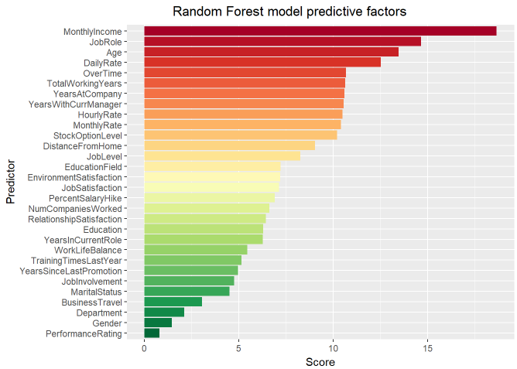
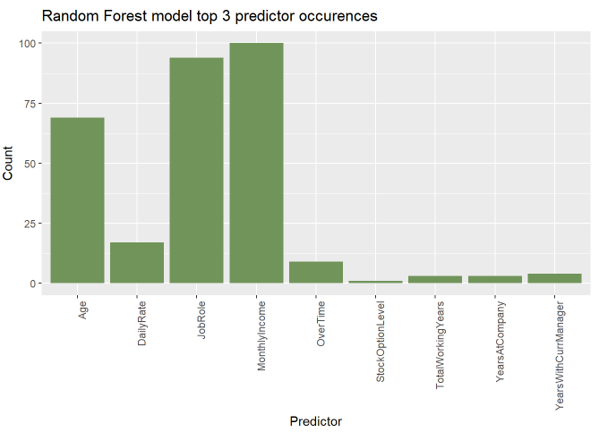
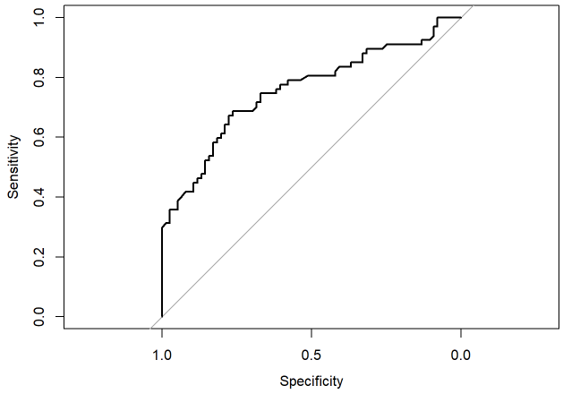
Random Forest Modeling
To better model the interaction of these several factors, a random forest model was developed
Monthly income, Job role, and age consistently show the highest prediction power for attrition
This will be further expanded upon in the next slides

Slide 6
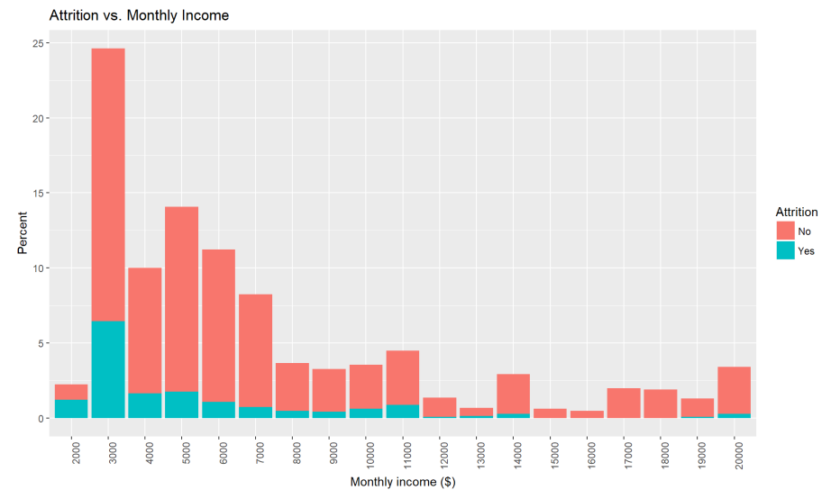
Data trends – Monthly income
Lower salary appears to show a significant relationship in turnover rates
While salary may be a major factor in turnover, it is important to note that some lower paying positions may be designed for transient workers which could bias results.

Slide 7
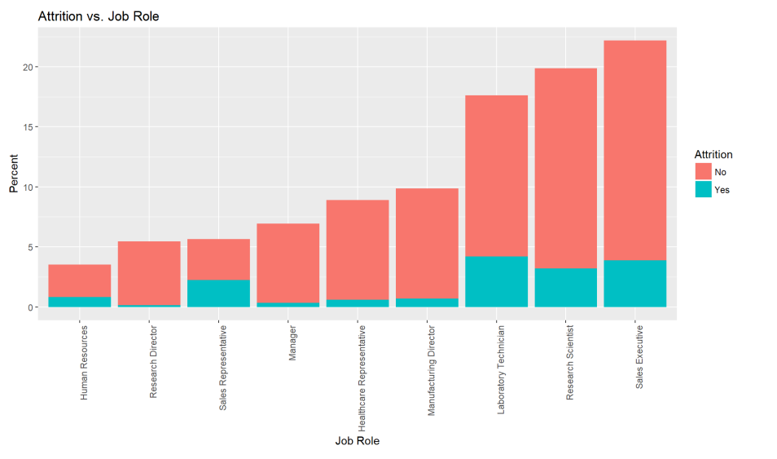
Data trends – Job role
Examining rob role trends, we do see high turnover rate for lab tech’s and sales representatives
This could be confounded by salary levels or other correlated factors, but it is a significant trend none the less

Slide 8
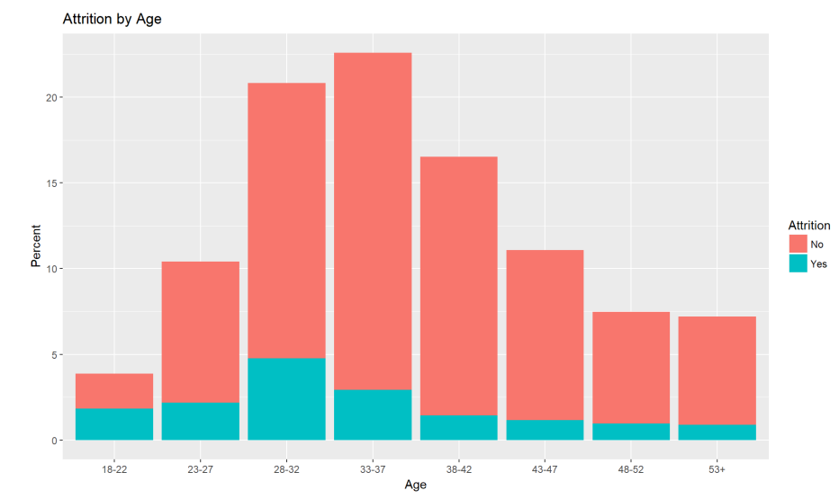
Data trends - Age
Attrition by age shows that younger groups do tend to have significantly higher turnover rates
This is particular pronounce for 18-22 & 23-27 groups.

Slide 9
Conclusion
The cross-validation for the Random Forest algorithm can provide a classification model with an average AUC value of 0.79. Therefore, the model can classify the attrition with good accuracy using the provided data.
Monthly income, Job role, and age are important factors to consider if trying to retain employees
The job roles that have the most turn over in this data set are Laboratory Technician, Research Scientist, Sales Executive, and Sale Representative.
It is important to remember that even giving employees excellent pay and other perks won’t guarantee retention. Factors that are harder to quantify can play a factor
Some weaker predictors, such as satisfaction scores, may be biased from employees feeling pressured to give more positive scores for fear of repercussions
These factors, in other words, affect the person’s decision to stay or move to another job.

